Slide 1
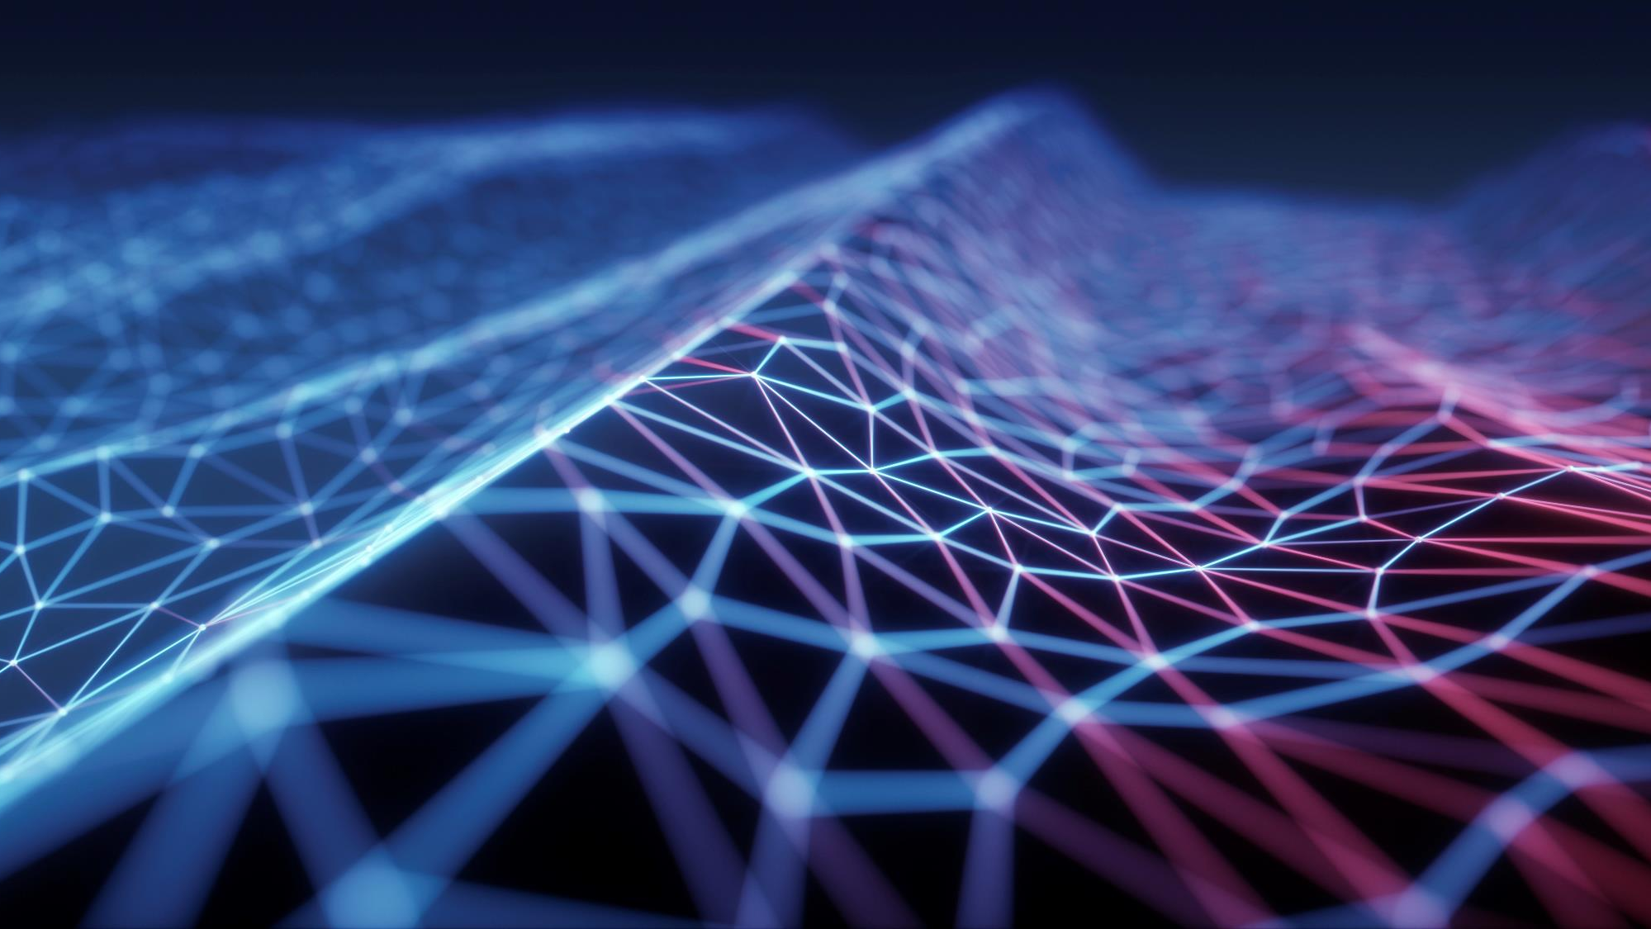

QUANTUM COMPUTING
Presented by : 3 STARS
Name | ID
Azmira Shekh | 221-15-5569
Rizwan Shariare Shopno | 221-15-4788
Nuha Rahman | 221-15-4795

Slide 2
Prepared for
Mr. Fahad Faisal
Assistant Professor
Dept. of Computer Science and Engineering
Faculty of Science and Information Technology
Daffodil International University

Slide 3
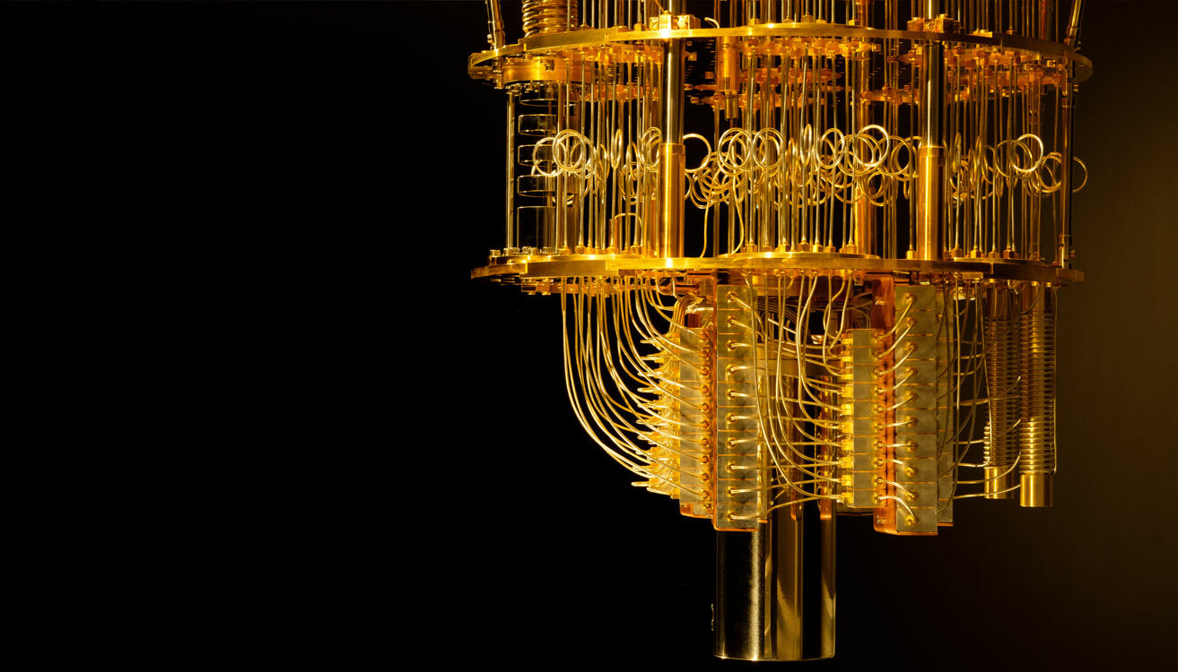
Overview
Introduction
Data Representation
Application
Implementation
Q&A

Slide 4
What is Quantum Computing?

Slide 5
What is “quantum” ?
First!
Quantum is the Latin word for amount.
But in modern understanding, it means the smallest possible discrete unit of any physical property, such as energy or matter.

Slide 6
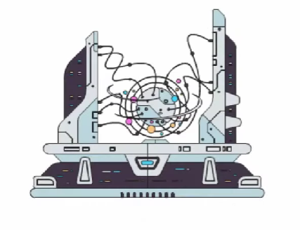
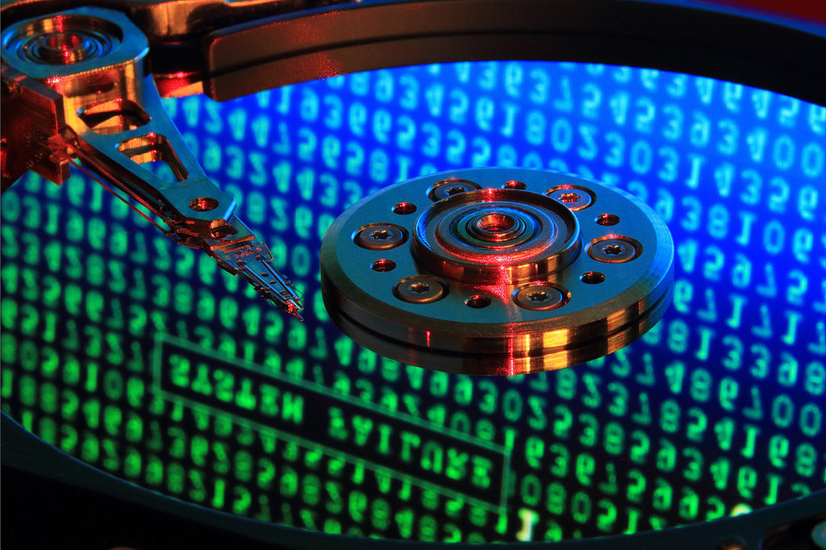
What is quantum computing ?
Quantum computing is the method of computing that performs calculations based on the laws of quantum mechanics, which is the behavior of particles at the sub-atomic level.
Quantum computing is made up of qubits. Unlike a normal computer bit, which can be 0 or 1,
a qubit can be either of those, or a superposition of both 0 and 1.

Slide 7
Representation of data
Quantum computers, which have not been built yet, would be based on the strange principles of quantum mechanics, in which the smallest particles of light and matter can be in different places at the same time.
In a quantum computer, one "qubit" - quantum bit - could be both 0 and 1 at the same time. So with three qubits of data, a quantum computer could store all eight combinations of 0 and 1 simultaneously. That means a three-qubit quantum computer could calculate eight times faster than a three-bit digital computer.
Typical personal computers today calculate 64 bits of data at a time. A quantum computer with 64 qubits would be 2 to the 64th power faster, or about 18 billion times faster.

Slide 8
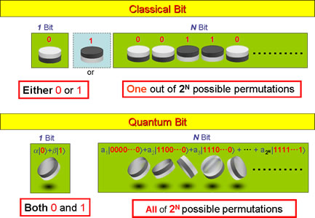
Representation of data – qubits
A bit of data is represented by a single atom that is in one of two states denoted by |0> and |1>. A single bit of this form is known as a qubit

Slide 9
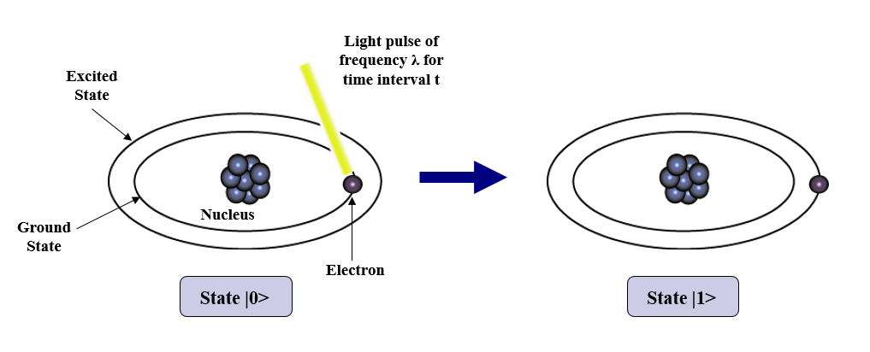
Representation of data – qubits (cont’d)
A physical implementation of a qubit could use the two energy levels of an atom. An excited state representing |1> and a ground state representing |0>.

Slide 10
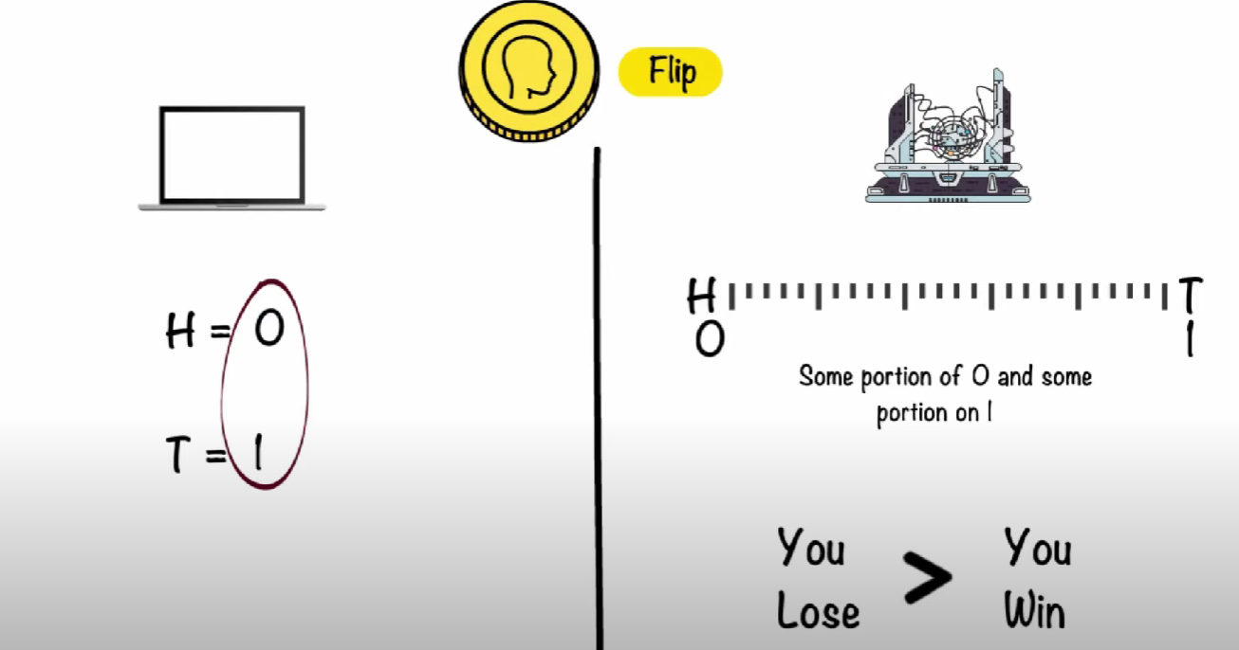
What makes the difference?
Uncertainty of outcomes.
computers would use transistors and depend on bits (= 1 or 0) and bytes.
Whereas, quantum computers use qubits which are a range.

Slide 11
Applications
Efficient simulations of quantum systems.
Phase estimation; improved time-frequency and other measurement standards. (e.g. GPS)
Factoring and Discrete Logarithms.
Hidden subgroup problems.
Amplitude amplification.
And much more…

Slide 12
Implementation requirements
Qubit implementation itself.
Control of unitary evolution.
Initial state preparation. (qubits)
Measurement of the final state(s).

Slide 13
Quantum Computer languages
Even though no quantum computer has been built that hasn’t stopped the proliferation of papers on various aspects of the subject. Many such papers have been written defining language specifications.
QCL - (Bernhard ¨ Omer) QCL (Quantum Computer Language) is the most advanced and first implemented quantum programming language. Its syntax resembles syntax of the C programming language and classical data types are similar to data types in C. The basic built-in quantum data type in QCL is qreg (quantum register).
qGCL - (Paolo Zuliani and others) Quantum Guarded Command Language.
http://web.comlab.ox.ac.uk/oucl/work/paolo.zuliani/
Quantum C - (Stephen Blaha) Currently just a specification,

Slide 14
References
“A survey of quantum computing and automata”. E. de Doncker and L. Cucos, In Fourth World Multiconference on Systemic, Cybernetics, and Informatics (SCI'00), (2000).
“The Temple of Quantum Computing”, Riley T. Perry.2004
“Quantum Computation:A Computer Science Perspective”, Anders K.H. Bengtsson. 2005
http://en.wikipedia.org/wiki/Quantum_computing
http://www.nec.co.jp/rd/Eng/innovative/E3/top.html
http://www.sciencedaily.com/

Slide 15
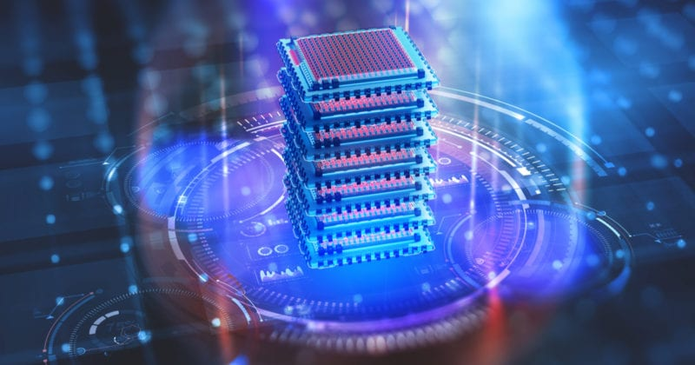

Q&A
.
.
Thank You

